Slide 1
This week: Multiple comparisons
Parametric tests:
Tukey’s HSD
> tukeyHSD()
Bonferroni test
> ghlt() in package: multcomp
Non-parametric tests:
Dunn’s test
> dunn.test() in package:dunn.test
Last week: Review session
Descriptive statistics
Plotting
ANOVA
> aov(response ~ treatment)
> Anova() to get an ANOVA table.
Testing assumptions
> leveneTest() in package:car to test for equal variances
> shapiro.test() to test for normality (residuals for ANOVA)
Kruskal-Wallis test
> kruskal.test(response ~ treatment)

Slide 2
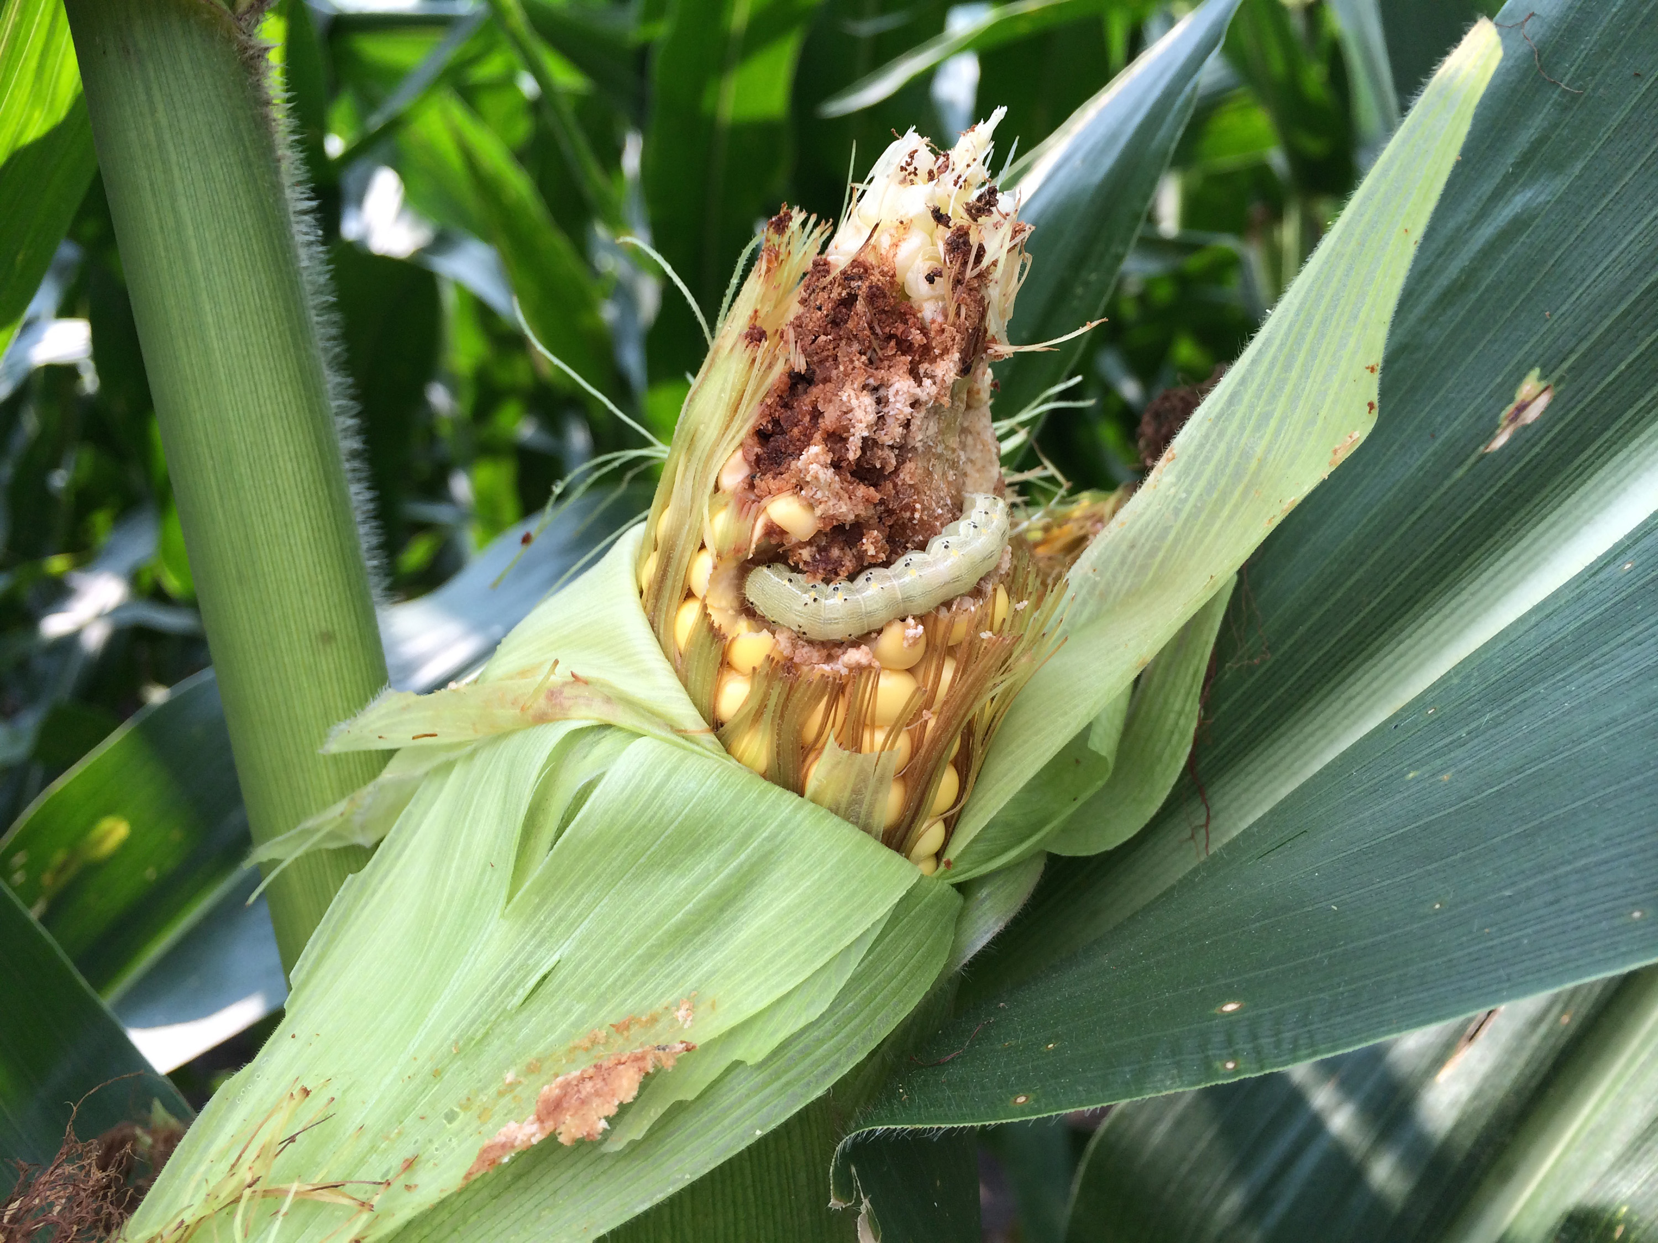

Exercise 1: ANOVA and multiple comparison
Data: The counts of insects in agricultural experimental units treated with different insecticides (sprays = A, B and C).
Instructions:
1. Run an ANOVA (assume that all assumptions have been met).
2. Conduct a multiple comparison that you think is relevant.
3. Plot your results.
4. Write a summary statement for both the ANOVA and multiple comparison tests.

Slide 3


Exercise 2: Kruskal-Wallis and multiple comparison
Data: Daily air quality measurements on Roosevelt Island, New York in 1973. Test whether the mean ozone (ppb) was different among the three months.
Instructions:
1. Run an Kruskal Wallis (assume that all assumptions have been met).
2. Conduct a multiple comparison that you think is relevant.
3. Plot your results.
4. Write a summary statement for both the Kruskal-Wallis and multiple comparison tests.

